Slide 1
BM424 Clinical Microbiology
Workshops: Pandemic Response
Workshop 3
Dr. Morgan Feeney and Dr. Arnaud Javelle
2024

Slide 2

The pandemic scenario
A pandemic has struck your beautiful city and is causing illness and death amongst the residents there
You have been divided into groups (A-H) – each group is working on a different scenario
A briefing packet with details of your pandemic scenario is available for each group on MyPlace

Slide 3
Pandemic response teams
You will be working as a group to try to understand the pandemic that is devastating your city, and to try to find solutions to stop the outbreak
Your group members are:
  Provost (head of the city council)
  Representative from a national public health org. (Public Health Scotland)
  Epidemiologist (on secondment from Public Health Scotland)
  Director of the city's main hospital
  City planner/civil servant
  Microbiologist (working in one of the NHS Scotland clinical labs)
  Public communications expert (past and current sci comm campaigns)
  Doctor from a large surgery
You each have different information/skillsets to bring to the team, but you will need to bring all of this together to understand the pandemic and make decisions

Slide 4

Solving the pandemic outbreak
Your team should come up with 3-5 specific action points to stop the pandemic
Next time we will provide you with more data (how your actions have affected the course of the pandemic in your scenario)

Slide 5
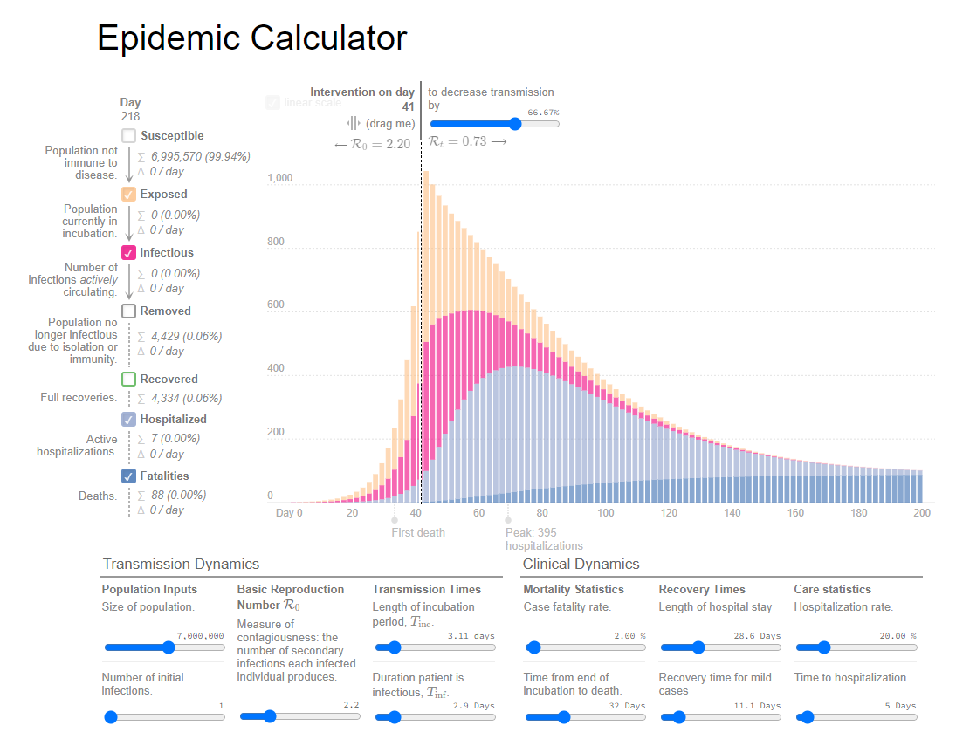
Using an S/I/R model to guide your decision-making
Evidence-based (peer-reviewed literature – can you justify any assumptions that you make?)
Transmission dynamics different for every disease (peer-reviewed literature again!)
Include your assumptions/rationale/evidence in your pro forma

Slide 6
Specific action points to stop the pandemic
Examples (from the SARS-CoV2 pandemic, may not be relevant to your scenario):
  Mandate that masks (FFP2 or better) are worn on public transportation
  Radio, TV, and print advertisement campaign promoting vaccination
Your action points should be as specific as possible – for example:
  If contact tracing/quarantine: what test will you use? who will trace the contacts? How long will the quarantine last?
Your action points should be evidence-based – use the peer-reviewed literature to decide on measures that will stop the pandemic in your scenario
Your action points may include directives to gather more information (e.g., contact tracing of current cases, microbiological testing of food/water, etc.)
Use the data/expertise of all group members
Be clear, concise, specific

Slide 7
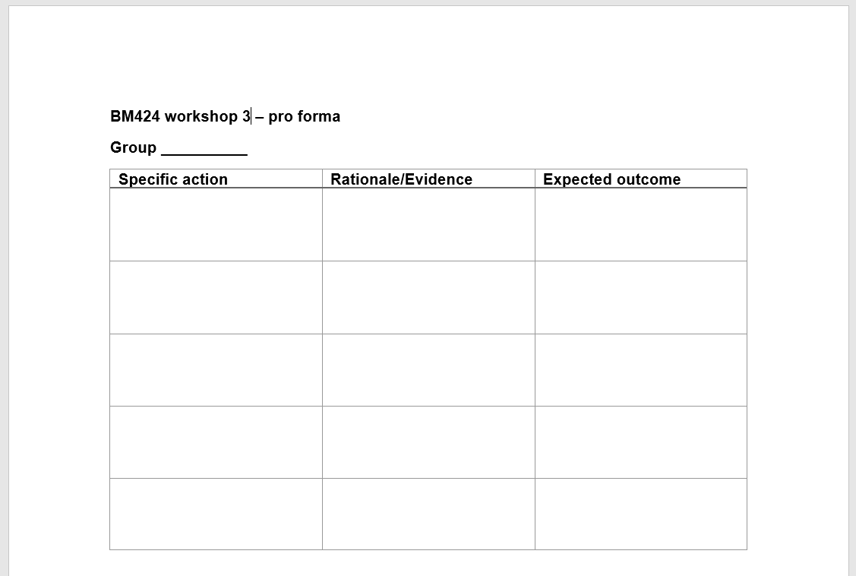
Specific action points to stop the pandemic
Fill out the workshop 3 pro forma with the specific actions that your group has agreed upon
Submit this to us (link on MyPlace) by noon on next Friday (March 1st) – only one person/group needs to submit

